Slide 1
DREAM WAKERS: Opening Activity
Read the author quote you received as you came in
Talk with someone who has a different quote
Share authors, quotes, and some of your own thoughts
Notes:
One really valuable part of Dream Wakers are the essays by many of the mentor authors whose books are featured.

Slide 2
An introduction to DREAM WAKERS: MENTOR TEXTS THAT CELEBRATE LATINO CULTURE
Presented by V. Diane Anderson, Teacher, IPS School 90
INTESOL November 11, 2017

Slide 3
Importance of Diverse Texts for Students
Help children identify with characters, settings, and pieces of information that are culturally relevant to them
Provide positive role models
Reinforce cultural identity
Expand their view of the world and the people in it
Facilitate acceptance of cultures different from one’s own culture page 2
Notes:
High-quality diverse texts help students identify in a positive way with their culture and develop a positive view of other cultures.

Slide 4
Importance of Diverse Texts for Students
Reading diverse children’s books in school can influence the social and identity development of all students in a classroom
Diverse texts help us understand ourselves, our neighbors, our society, our world
Access to diverse texts can make a difference in the reading lives of students and in their perception of themselves as thinkers, learners, and citizens
page 3
Notes:
If we are lucky, we all have important books that have helped shape our view of the world, develop our moral compass and sense of compassion- because in their pages we found ourselves. We are also lucky to find books that allow us to hear voices from a variety of cultures and gain multiple perspectives. The question is, will our students fall in love with reading and read so widely if they don’t find themselves in the books they read?

Slide 5
Importance of Diverse Texts for Students
When children don’t see themselves reflected in their books… they are being told in one of the most effective and powerful ways that their experience is not valuable, and by extension, neither are they.
BOOKS
CONVEY POWERFUL MESSAGES
ABOUT
WHAT– AND WHO–
MATTERS pages 4, 6
Notes:
Remember this thought: Books convey powerful messages about WHAT and WHO matters

Slide 6
Why Mentor Texts?
It simply makes sense to use the brilliant work of authors to teach writing and inspire students to write. Think of it as having an infinite number of extra hands helping you.
page 8
Notes:
Research supports the use of reading to improve writing, and even suggests the way to accomplish it- using models. Reading and writing use the same intellectual strategies, the processes are similar, and they use many of the same skills.

Slide 7
Getting to Know Dream Wakers
Organized by traits of writing: ideas, organization, voice, word choice, sentence fluency and conventions
Key qualities of each trait
Choosing mentor texts for the trait
More information about the trait
Book lists with annotations for teaching the trait
(Scattered throughout- Author Essays)

Slide 8
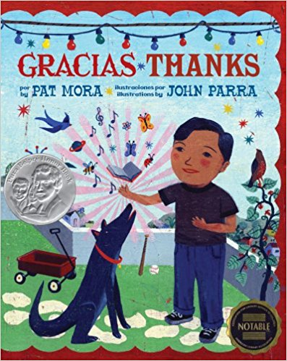
Try a Mentor Text Writing Activity
Mentor Text: Gracias/Thanks by Pat Mora
Read the book. Show students the phrasing
pattern, and have them create their own
“thanks” to include in a class Gracias/Thanks
book.
page 108

Slide 9
Gracias/Thanks
Por la mariquita que se posó en mi dedo, una pequeňa sorpresa voladora roja, gracias.
For the ladybug that landed on my finger, a little red
flying surprise, thanks.
------------------------------------------------
Por mamá, que encontró mi tarea en la basura, gracias.
For Mom, who found my homework in the trash, thanks.

Slide 10
Gracias/Thanks
Por los gusanos que atrajeron al gran pez que tiró
mi hilo de pescar, gracias.
For the worms that brought the big fish to tug on my
line, thanks.
* * * * * * * * * * * * * * * * * * * * * * * * * * * * * * * * * * * * * * * * * * * * * * * * * * * * * * * * * * * * * *
Por mis piyamas viejos, tan suaves que me siento como
si me estuviera poniendo aire, gracias.
For my old pajamas, so soft they feel like I’m putting on air, thanks.

Slide 11
Getting to Know Some Mentor Texts Activity
Look at one of the mentor texts
Read Ruth’s notes and suggestions from Dream Wakers and write some notes, adding ideas you have for using the book OR
Examine a book using some criteria for evaluation and
information about the 6 Writing Traits, and write notes
about how to use the book
With a partner or small group, share “book commercials”
Notes:
In the books I have brought to share, you will find inside the front cover either Ruth Culham’s comments and suggestions from Dream Wakers or a list of some of the criteria she used to evaluate books inside the books- the books with the evaluation are titles that were published after her book, and a few books I have used that were not in Dream Wakers. You might also look at the Epic books website if you already have an account set up and search for my collection of Dream Wakers authors and their books.

Slide 12
Please complete evaluation
Remember, the PowerPoint and handouts are on the INTESOL link
Book Winners!!!
Closing Thought:
Read and write with your students using diverse texts as mentors- magic will happen!

