Slide 1
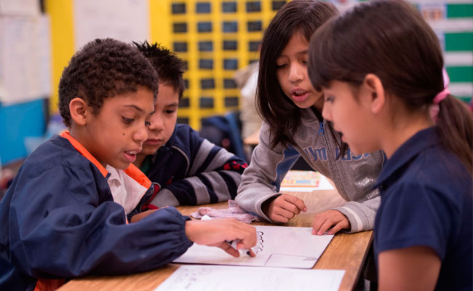
Teaching Without
Words
Adriana Berry and Jessica Brenn

Slide 2
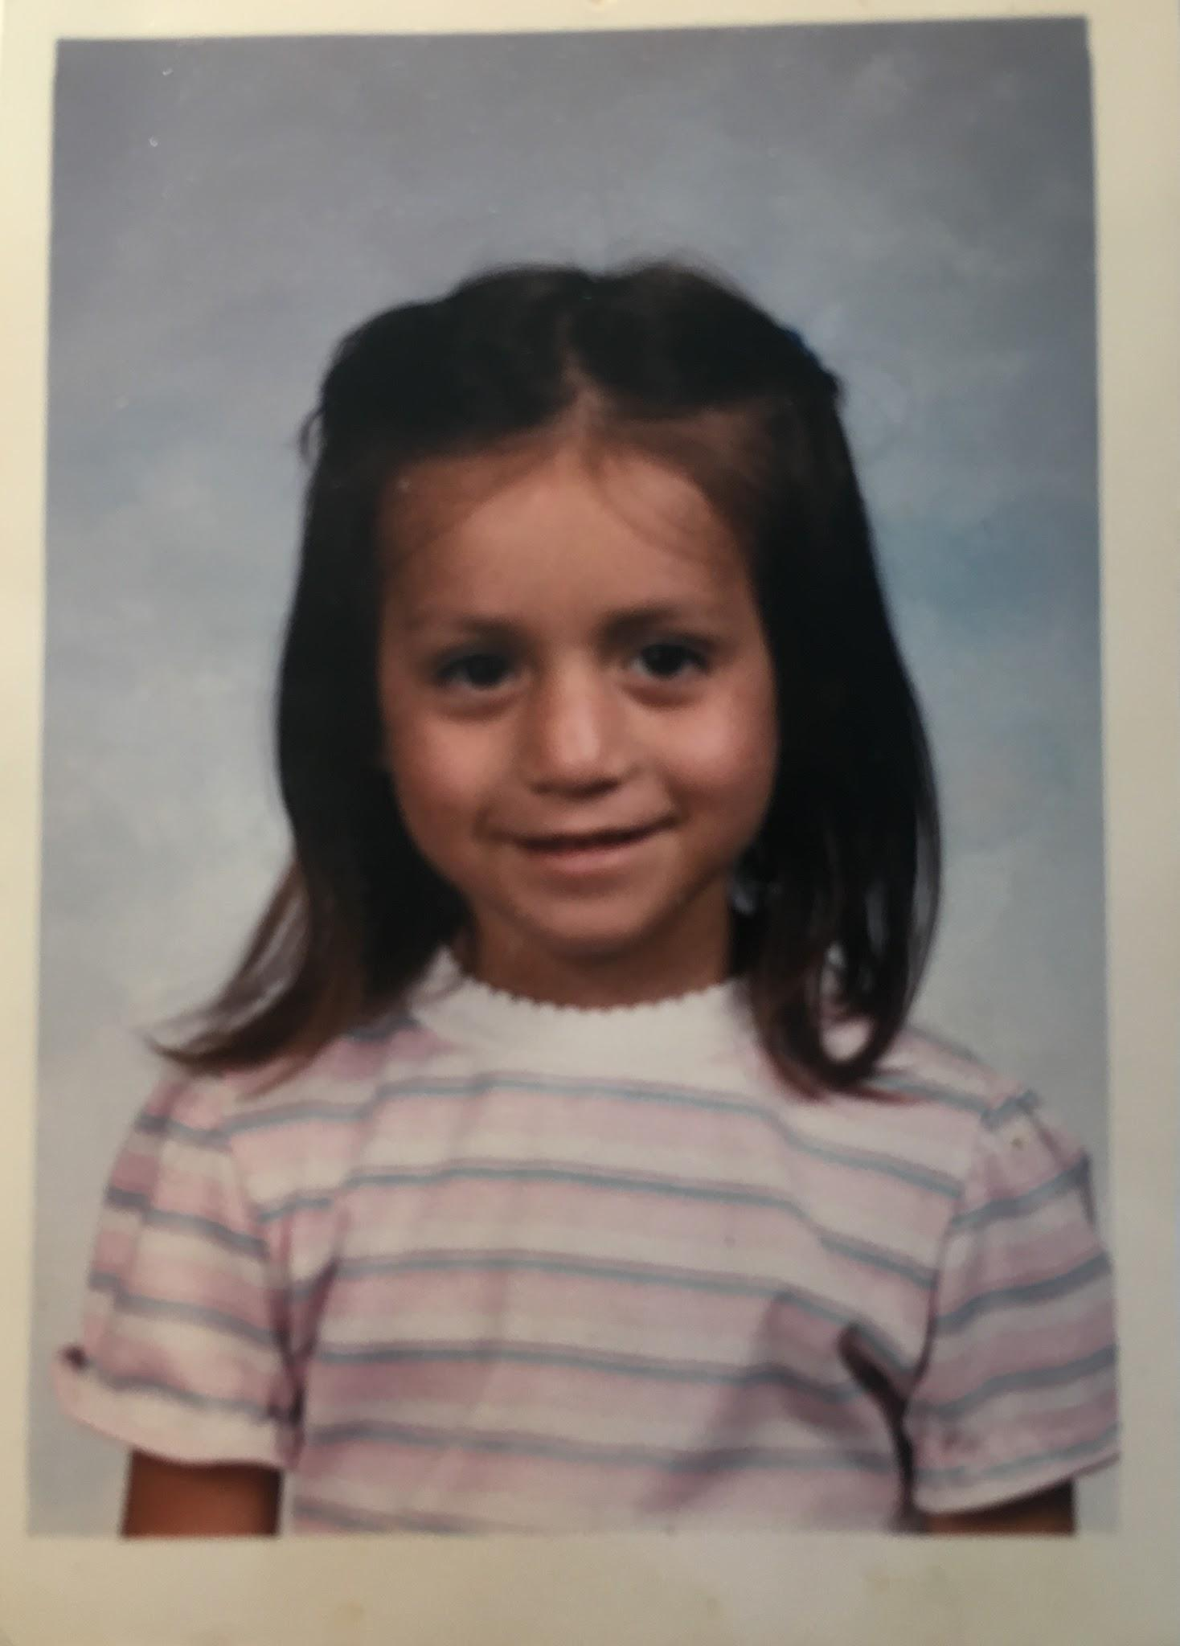
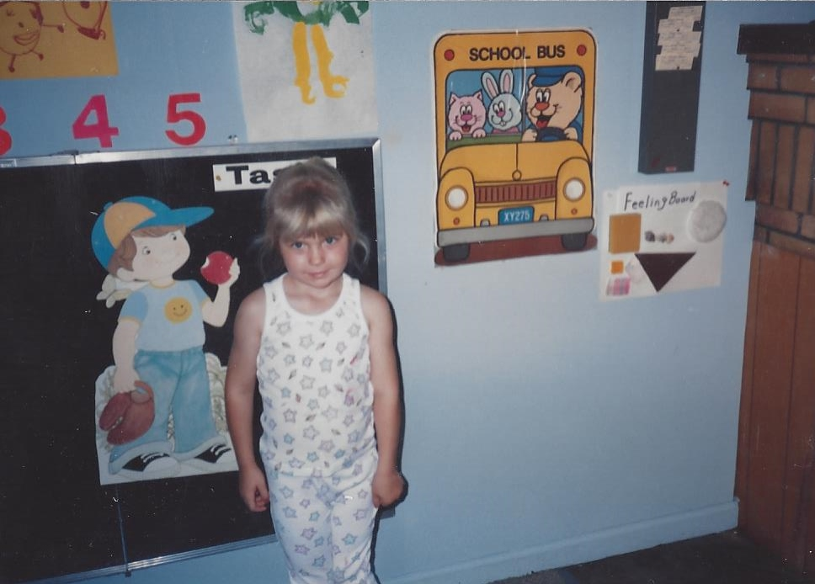
Introduction
Notes:
Jessica & Adriana

Slide 3
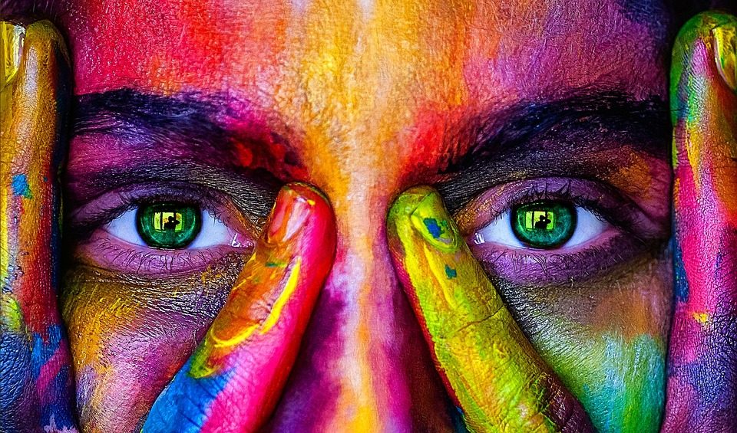
Research
BICS
CALP
Brain Rules, John Medina
WIDA
Notes:
Adriana
Bics -
Smarter Charts Book John Medina
WIDA - 4 domains, listening, speaking, writing, & reading

Slide 4
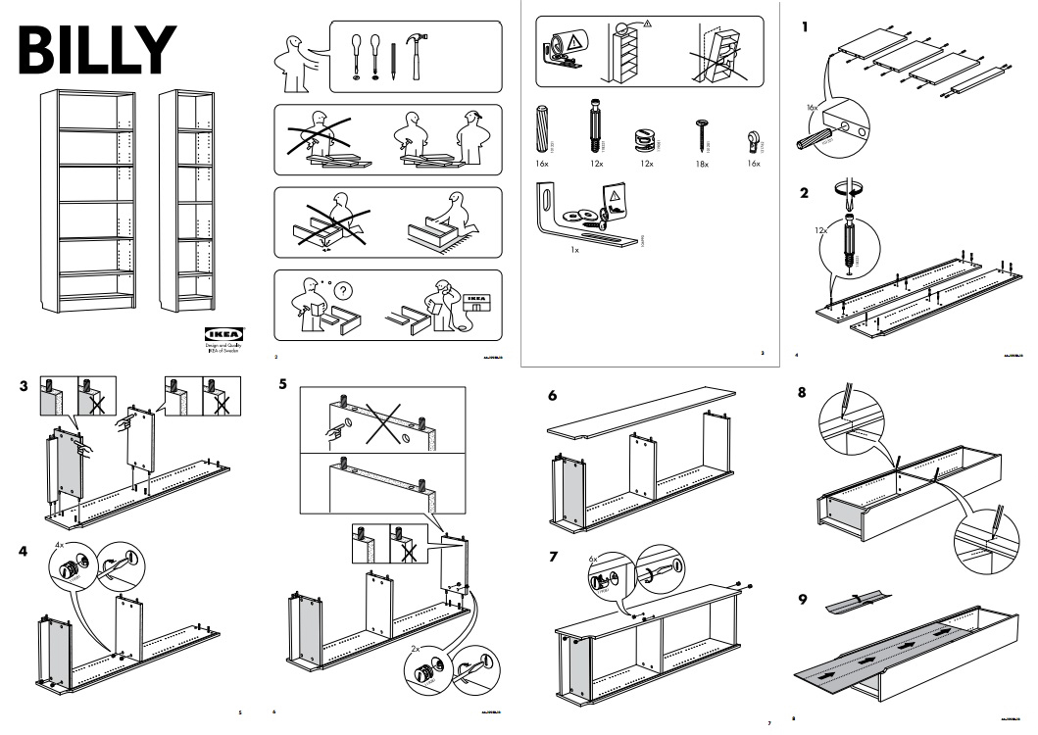
Notes:
Adriana
First Memory
Ikea Rationale

Slide 5
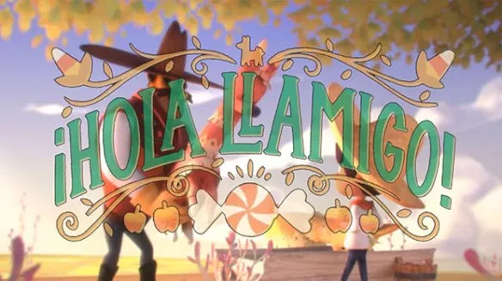
Notes:
Jessica
Model with picture cards, turn and talk, what happened in the movie, beginning, middle and end.

Slide 6
Wordless Books
Notes:
Adriana Berry

Slide 7
Notes:
Adriana

Slide 8
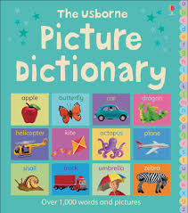
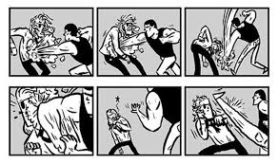
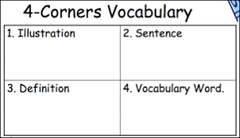
Notes:
Jessica

Slide 9
Notes:
Jessica

Slide 10
Strategies
Gallery Walk
KWL
Concept/Idea Map
Picture Notes
4 Corner Vocab
Graphic Novels
Picture Dictionary
Storyboards - Powtoon
Props
Pictures
Diagrams
Maps
Charts
Symbols
Signs
Icons
Gestures
Facial Expressions
Labeling

Slide 11
Images
Pixabay
Unsplash
Pexels
Gratiosography
Unsplash
Life of Pics

Slide 12
Free & Public Domain Image
Websites to use with Students
The commons
Getty Open
Content Images
Getty Images
Pixabay
Openclipart
Wikimedia Commons

